Slide 1
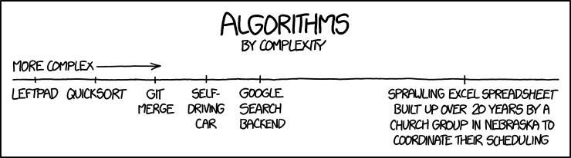
COMP20007 Design of Algorithms: Week 12

Slide 2


Slide 3
Approaches to determining complexity
Inspect the nested loop structure
Write down the recurrence and solve it directly
Write down the recurrence and apply the Master Theorem
(know the Master Theorem)
Consider how many times the nodes or edges are accessed in total

Slide 4
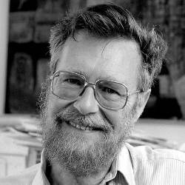
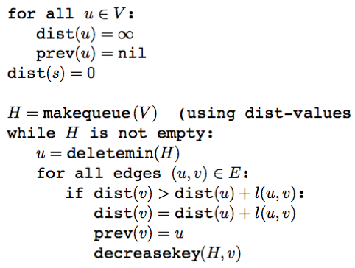
Dijkstra's Algorithm
Edsger Dijkstra

Slide 5
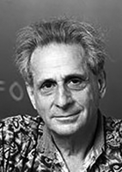
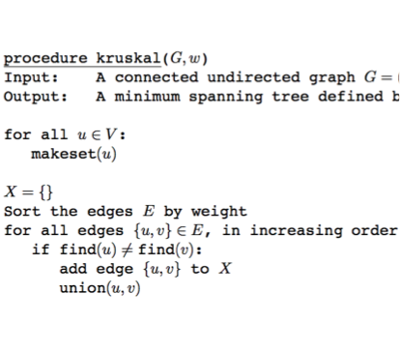
Kruskal's Algorithm
Joseph Kruskal

